Slide 1

DS 2003: Communicating with Data
Fall 2022

Slide 2


About the Instructor
Natalie Kupperman (Cup-er-man) (she/her/hers)
PhD in Kinesiology – Sports Med (double Hoo!)
Got into data science through Sports Science/Biometrics
Trained as an Athletic Trainer – worked clinically for 8 years

Slide 3
About the TA
Maecenas faucibus
Mollis interdum
Cras mattis consectetur
Purus sit fermentum
Cras justo odio

Slide 4
Introduce Yourself
Major
Year

Slide 5
Pre-class Survey
Please complete by August 28th

Slide 6
Course Structure
Syllabus
Grading
Expectations

Slide 7
R/R Studio Install
Detailed instructions were sent out last week

Slide 8
Specific R Packages We Will Cover

Slide 9
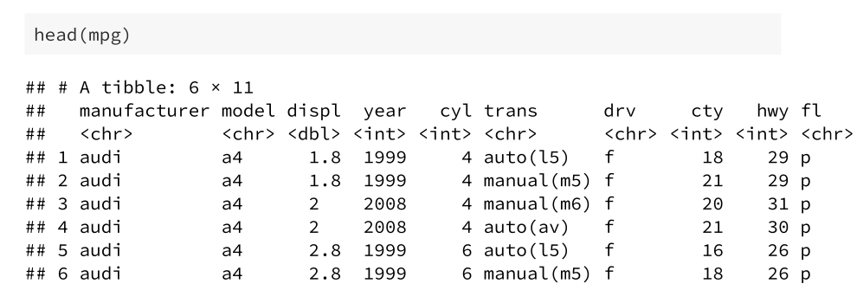
Example Data
mpg data from ggplot2 package
This dataset contains fuel economy data from 1999 to 2008 for 38 popular models of cars
Data from with 234 rows and 11 variables
For more info about mpg data, use ?mpg

Slide 10
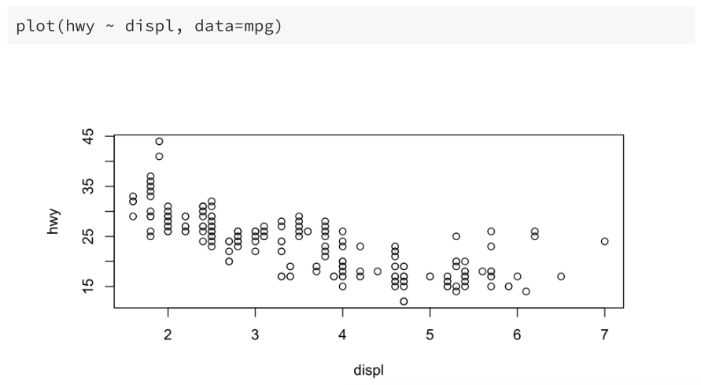
Base R
Default plotting functions like plot() and hist()
Scatterplot: engine displacement by highway miles per gallon

Slide 11
ggplot2
Ggplot2 is a system for declaratively creating graphics base on The Grammar of Graphics

Slide 12
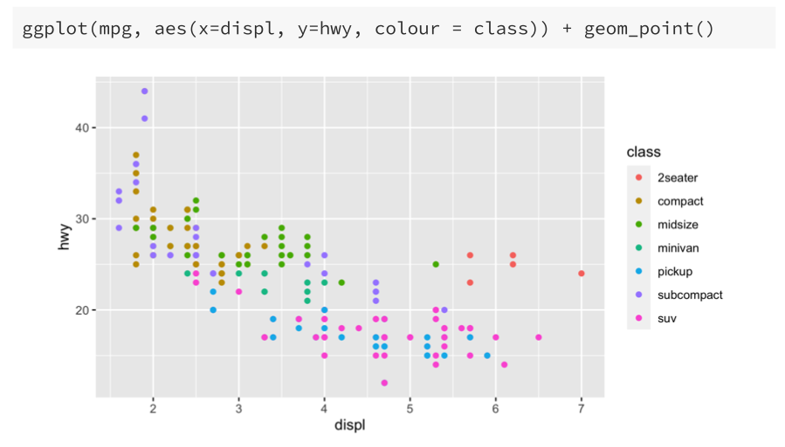
ggplot2

Slide 13
plotly
plotly is an R package for creating interactive web-based graphs

Slide 14
Shiny
Shiny is an R package that makes it easy to build interactive web applications straight from R
Example: https://youmi.shinyapps.io/curobustml/
Examples: https://shiny.rstudio.com/gallery/

